Slide 1
BUDGET, VOUCHERS, AND PER CAPITA
Knights of Columbus
K.C.L.S.
July 16, 2016

Slide 2
Annual Budget
It is strongly recommended that an Annual Budget be prepared at each Council
“Work with the Treasurer and Financial Secretary in preparing a Council Budget.” (Grand Knight’s Handbook).
Budget can be prepared by anyone assigned the task.
Shall follow guidelines established by the Council
Should contain as much detail as possible

Slide 3
Budget Development
Makes it efficient to pay bills -- An approved Council Budget (through Resolution Process) means the Membership has given Permission to write the checks to cover the expenses. It is still a good idea to bring them up as a bill at a meeting.
Budget for both expected Income and Expenses throughout the year (be Realistic)
Remember to be as detailed as possible (e.g., MDF contribution, gifts for Altar Servers, etc.)

Slide 4
Budget Development
Income Budgeting
Budget for ‘guaranteed’ or fixed income
Membership dues
Any other income specific to Council
Budget for other expected income on a line item basis – e.g., fundraisers, donations, YEP contributions, etc.

Slide 5
Budget Development
Expense Budgeting
Budget for Mandatory Expenses – i.e., obligations to Supreme and the State Council
Also, it is recommended that each Council budget for Travel Expenses for those required to attend KCLS, Grand Knights Day and the State Convention
Budget for Council Programs and their expected expenses using as many detailed line items as required

Slide 6
Budget Development
Adjust budgeted amounts to balance or meet any other Council requirements or expectations
Add line items as needed to meet requirements (additional fundraiser, new program, charity expenditures, etc.)
Use whatever format and/or program that works well for the Council and its leadership
Begin to prepare early to allow time for review and adoption of the final budget by the Council

Slide 7
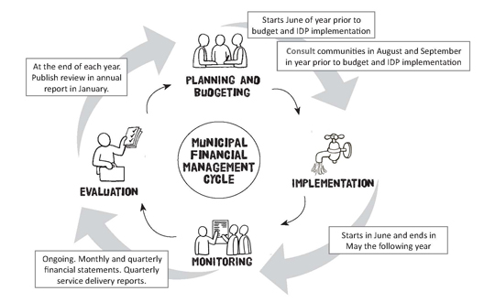
Budget Cycle
Consult with new Council Officers, Directors and Chairman
Review End of Year Reporting for Shortfalls/Overages early in July
Finalize Budget by mid July of new Columbian Year
Starts in July and ends in June the following year
Ongoing Monthly and Quarterly Reporting of Financial Activity

Slide 8
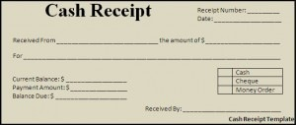
Receipt & Voucher System
Each and every Council shall use a Receipt and Voucher system for receipt of money and payment of bills as this is the proper process
This ensures proper handling of Council funds
Also allows for an efficient, complete, and accurate semiannual audits for the Council
For complete records, it shall be used for all bills even those that do not require Council membership approval, e.g. per Capita, etc.

Slide 9
Receipt of Money
Financial Secretary receives all moneys for Council

Slide 10
Receipt of Money
Financial Secretary receives all moneys for Council
Financial Secretary develops Transmittal & issues moneys to Treasurer

Slide 11
Receipt of Money
Financial Secretary receives all moneys for Council
Financial Secretary develops Transmittal & issues moneys to Treasurer
Treasurer receives monies & issues Receipt to
Financial Secretary
(Form 281)

Slide 12
Receipt of Money
Treasurer creates Bank Deposit Slip, Deposits Moneys
& obtains Bank Deposit Receipt
Financial Secretary receives all moneys for Council
Financial Secretary develops Transmittal & issues moneys to Treasurer
Treasurer receives monies & issues Receipt to
Financial Secretary
(Form 281)

Slide 13
Receipt of Money
Treasurer creates Bank Deposit Slip, Deposits Moneys
& obtains Bank Deposit Receipt
Financial Secretary receives all moneys for Council
Financial Secretary develops Transmittal & issues moneys to Treasurer
Treasurer receives monies & issues Receipt to
Financial Secretary
(Form 281)
Financial Secretary submits Receipt (Form 281) to GK to be verified at next Council Meeting

Slide 14
Receipt of Money
Treasurer creates Bank Deposit Slip, Deposits Moneys
& obtains Bank Deposit Receipt
Treasurer submits Bank Deposit Receipt to GK to be verified at next Council Meeting
Financial Secretary receives all moneys for Council
Financial Secretary develops Transmittal & issues moneys to Treasurer
Treasurer receives monies & issues Receipt to
Financial Secretary
(Form 281)
Financial Secretary submits Receipt (Form 281) to GK to be verified at next Council Meeting

Slide 15
Receipt of Money
Treasurer creates Bank Deposit Slip, Deposits Moneys
& obtains Bank Deposit Receipt
Treasurer submits Bank Deposit Receipt to GK to be verified at next Council Meeting
Financial Secretary receives all moneys for Council
Financial Secretary develops Transmittal & issues moneys to Treasurer
Treasurer receives monies & issues Receipt to
Financial Secretary
(Form 281)
Financial Secretary submits Receipt (Form 281) to GK to be verified at next Council Meeting
This Process occurs at each meeting

Slide 16
Receipt of Money
Treasurer creates Bank Deposit Slip, Deposits Moneys
& obtains Bank Deposit Receipt
Treasurer submits Bank Deposit Receipt to GK to be verified at next Council Meeting
Financial Secretary receives all moneys for Council
Financial Secretary develops Transmittal & issues moneys to Treasurer
Treasurer receives monies & issues Receipt to
Financial Secretary
(Form 281)
Financial Secretary submits Receipt (Form 281) to GK to be verified at next Council Meeting
This Process occurs at each meeting
FS: FS Transmittal(c) & Tres Receipt(o)
Tres: FS Transmittal(o), Tres Receipt(c), Bank Deposit(c) & Bank Receipt(o)

Slide 17
Receipt of Money
The Grand Knight must carry out the “Order of Business” set forth in Section 125
This includes reading at each Council meeting…
… the Treasurer’s Receipt to the Financial Secretary for all moneys received at the close of the previous meeting
… and the Treasurer’s Bank Receipts of deposit, showing that the money was deposited in the bank.
This establishes the amount being collected and enables the Grand Knight to know whether it is all that should be deposited

Slide 18
Payment of Bills
Bill properly approved
(By-Laws or
Council Vote)

Slide 19
Payment of Bills
Bill properly approved
(By-Laws or
Council Vote)
Financial Secretary generates a Voucher (Form 157 or Member Billing*)
* Voucher section of the Council Ledger.

Slide 20
Payment of Bills
Bill properly approved
(By-Laws or
Council Vote)
Financial Secretary generates a Voucher (Form 157 or Member Billing*)
Grand Knight then signs Voucher authorizing Treasurer to issue check
* Voucher section of the Council Ledger.

Slide 21
Payment of Bills
Treasurer prepares Check per Voucher signed by both Treasurer and
Grand Knight
Bill properly approved
(By-Laws or
Council Vote)
Treasurer prepares Check per voucher signed by both Fin Sec and Grand Knight
Financial Secretary generates a Voucher (Form 157 or Member Billing*)
Grand Knight then signs Voucher authorizing Treasurer to issue check
* Voucher section of the Council Ledger.

Slide 22
Payment of Bills
Treasurer prepares Check per Voucher signed by both Treasurer and
Grand Knight
Bill properly approved
(By-Laws or
Council Vote)
Treasurer prepares Check per voucher signed by both Fin Sec and Grand Knight
Treasurer signs Check and obtains Grand Knight Signature on Check (2 Signatures)
Financial Secretary generates a Voucher (Form 157 or Member Billing*)
Grand Knight then signs Voucher authorizing Treasurer to issue check
* Voucher section of the Council Ledger.

Slide 23
Payment of Bills
Treasurer prepares Check per Voucher signed by both Treasurer and
Grand Knight
Bill properly approved
(By-Laws or
Council Vote)
Treasurer prepares Check per voucher signed by both Fin Sec and Grand Knight
Treasurer signs Check and obtains Grand Knight Signature on Check (2 Signatures)
Financial Secretary generates a Voucher (Form 157 or Member Billing*)
Grand Knight then signs Voucher authorizing Treasurer to issue check
Council Check is ready to be issued
(Pay the Bills)
* Voucher section of the Council Ledger.

Slide 24
Payment of Bills
Treasurer prepares Check per Voucher signed by both Treasurer and
Grand Knight
Bill properly approved
(By-Laws or
Council Vote)
Treasurer prepares Check per voucher signed by both Fin Sec and Grand Knight
Treasurer signs Check and obtains Grand Knight Signature on Check (2 Signatures)
Financial Secretary generates a Voucher (Form 157 or Member Billing*)
Grand Knight then signs Voucher authorizing Treasurer to issue check
Council Check is ready to be issued
(Pay the Bills)
* Voucher section of the Council Ledger.
This Process occurs at each meeting

Slide 25
Payment of Bills
Treasurer prepares Check per Voucher signed by both Treasurer and
Grand Knight
Bill properly approved
(By-Laws or
Council Vote)
Treasurer prepares Check per voucher signed by both Fin Sec and Grand Knight
Treasurer signs Check and obtains Grand Knight Signature on Check (2 Signatures)
Financial Secretary generates a Voucher (Form 157 or Member Billing*)
Grand Knight then signs Voucher authorizing Treasurer to issue check
Council Check is ready to be issued
(Pay the Bills)
* Voucher section of the Council Ledger.
This Process occurs at each meeting
FS: Invoice/Bill(o) & FS Voucher(c)
Tres: FS Voucher(o), Council Check Stub(o), Bank Statement(o)

Slide 26
Payment of Supreme or State Obligation
A Supreme or State Council obligation does not require Council approval, as outlined in Section 145
Receipt of the monthly Council Statement from Supreme is the official notice that the amount owed is due and payable
The same is true of a billing from the State Council

Slide 27
Supreme Obligations
Council Billed on January 1 and July 1 (Members on Record)
Per Capita Tax [PCT] -- $1.75 per Member.
Catholic Advertising Fund [CAF] -- $0.50 per Member
Culture of Life [COL] -- $1.00 per Member.
Council Supply Charges -- Billed for Supply items that they order as well as any shipping and handling fees

Slide 28
State Obligations
State Per Capita Tax
Billed on January 1 and July 1.
$4.25 per regular Member.
$2.50 for Inactive and Honorary Members.
No charge for Honorary Exempt or Disabled Members.
KCLS and Grand Knights Day
$15 for KCLS per Council (Not Optional)
$15 for GK Day per Council (Not Optional)
Exemplification Fund
$15 per new Member (Res #12, 2015 LA Conv)
Note: Councils not up to date with payments will not be seated at the State Convention.

Slide 29
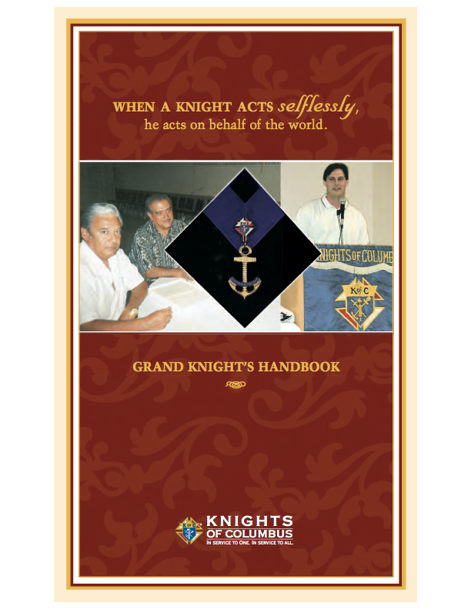
References
District Deputy Handbook
Grand Knight Handbook
Financial Secretary Handbook

Slide 30
References
Kofc.org
Under “Officer’s Online”
Then “Officer’s Desk Reference”
Then “Financial Issues”

Slide 31
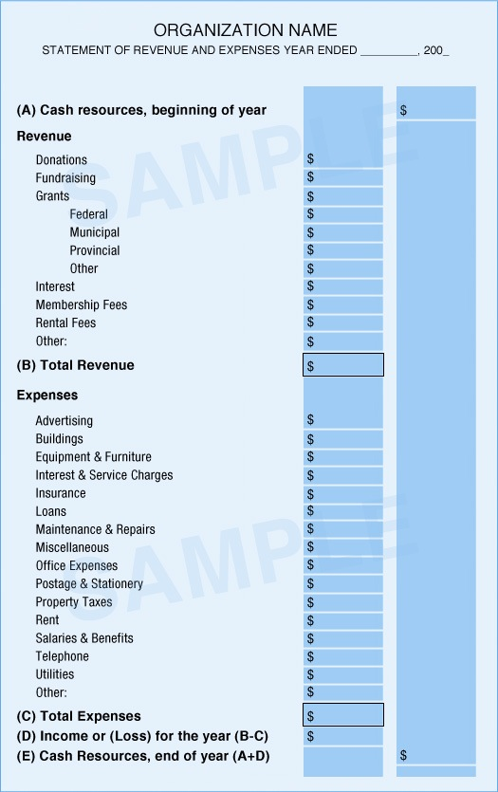
Budget, Vouchers, and per Capita
Questions?

Slide 32
COUNCIL AUDITS
Knights of Columbus
K.C.L.S.
July 16, 2016

Slide 33
Council Audit
Semi-annual Audits are documented on Form 1295 must be conducted by all Councils
Audit Reports are Due August 15 and February 15
Grand Knight and Trustees must Conduct the Audit
Under no Circumstances should either the Financial Secretary or the Treasurer Prepare the Audits
Financial Secretary and Treasurer are to be available at the Audit to provide Documentation and answer Questions regarding the Council Records
Recorder’s Minute Book is to be available

Slide 34
Council Audit
All three sections of the Audit Report (#1295) must be completed (Membership, Cash Transactions and Assets /Liabilities)
Audit Report must be signed by the Grand Knight and at least two (2) Trustees
Completed Audit Reports are to be sent to Supreme “Council Accounts, State Deputy, District Deputy and Council files

Slide 35
Council Audit Records
Record and Items Needed to Prepare the Audit:
From the Financial Secretary:
Cash Receipts records
Warrant Voucher Stubs
Receipts, Treasurer to Financial Secretary
Latest Council Roster
Council Statements for the Audit Period
Cash and Checks on hand, if any
Bills or Invoices requiring payment
Copy of last Council Audit

Slide 36
Council Audit Records
Record and Items Needed to Prepare the Audit:
From the Treasurer:
Treasurer’s Cash Book
Check Book, Bank Statements, Cancelled Checks
Warrant Vouchers for the Audit Period
All Bank Books, regardless of the purpose of Account
All Documents reflecting Cash or Liquid Assets (ie., Stocks, Bonds, Notes, etc.)

Slide 37
Council Audit Records
Record and Items Needed to Prepare the Audit:
From the Recorder:
Council Minute Book

Slide 38
Council Audit Bonding
The Knights of Columbus provides a Bond for the Financial Secretary and Treasurer for each Council, but the Bonding Company can Refuse to Honor the Bond for the following reasons:

Slide 39
Council Audit Bonding
The Knights of Columbus provides a Bond for the Financial Secretary and Treasurer for each Council, but the Bonding Company can Refuse to Honor the Bond for the following reasons:
Failure of the Trustees to conduct the audit

Slide 40
Council Audit Bonding
The Knights of Columbus provides a
Bond for the Financial Secretary and Treasurer for each
Council, but the Bonding Company can Refuse to Honor
the Bond for the following reasons:
Failure of the Trustees to conduct the audit
Signing an Audit prepared by the Financial Secretary or Treasurer

Slide 41
Council Audit Bonding
The Knights of Columbus provides a Bond for the Financial Secretary and Treasurer for each Council, but the Bonding Company can Refuse to Honor the Bond for the following reasons:
Failure of the Trustees to conduct the audit
Signing an Audit prepared by the Financial Secretary or Treasurer
Failure to have on file at the Supreme Council office two (2) consecutive Audit Reports for the immediate past periods

Slide 42
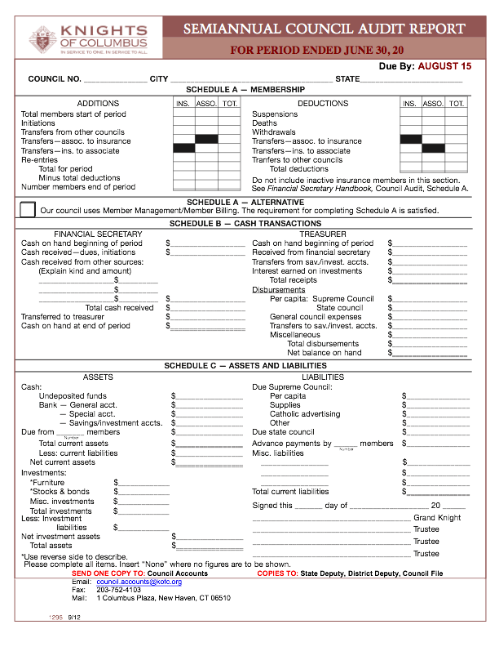
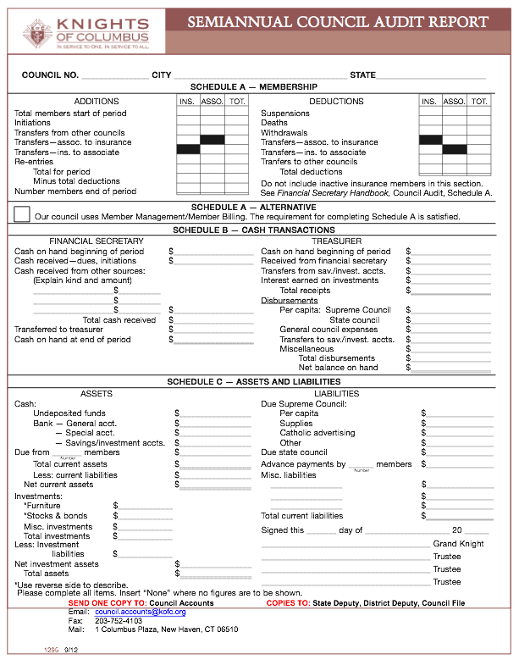
Council Audit Reports
FOR PERIOD ENDED DECEMBER 31, 20
Due By: FEBRUARY 15
Audit Form 1295-1
Due August 15
Audit Form 1295-2
Due February 15

Slide 43
Council Audit Reports
Supreme Reporting for the Knights of Columbus Louisiana Councils Submitting an Audit Report Form 1295, due 8/15/16:
Number of Councils Required to Report = 318
Council Delinquent due to Suspension = 22
Councils Delinquent Last 2 Periods = 68
Councils Delinquent Only Last Period = 12
Total # of Delinquent Councils (Active) = 58
Percentage of Councils (Active) Delinquent = 20%
Audit Form 1295-1
Due August 15
Audit Form 1295-2
Due February 15

Slide 44
Delinquent Council Audit Reports
Audit Form 1295-2
Due February 15
Audit Form 1295-1
Due August 15

Slide 45
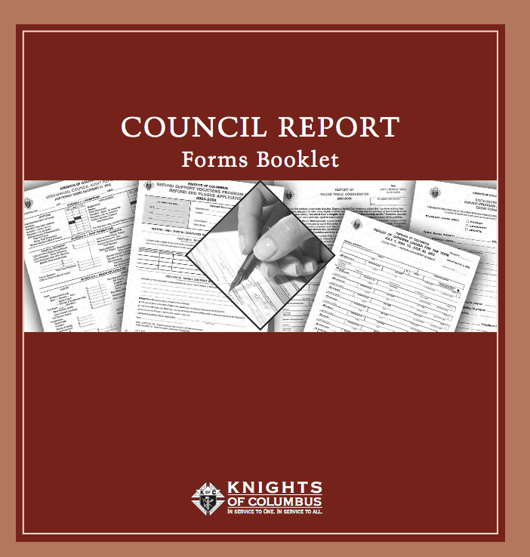
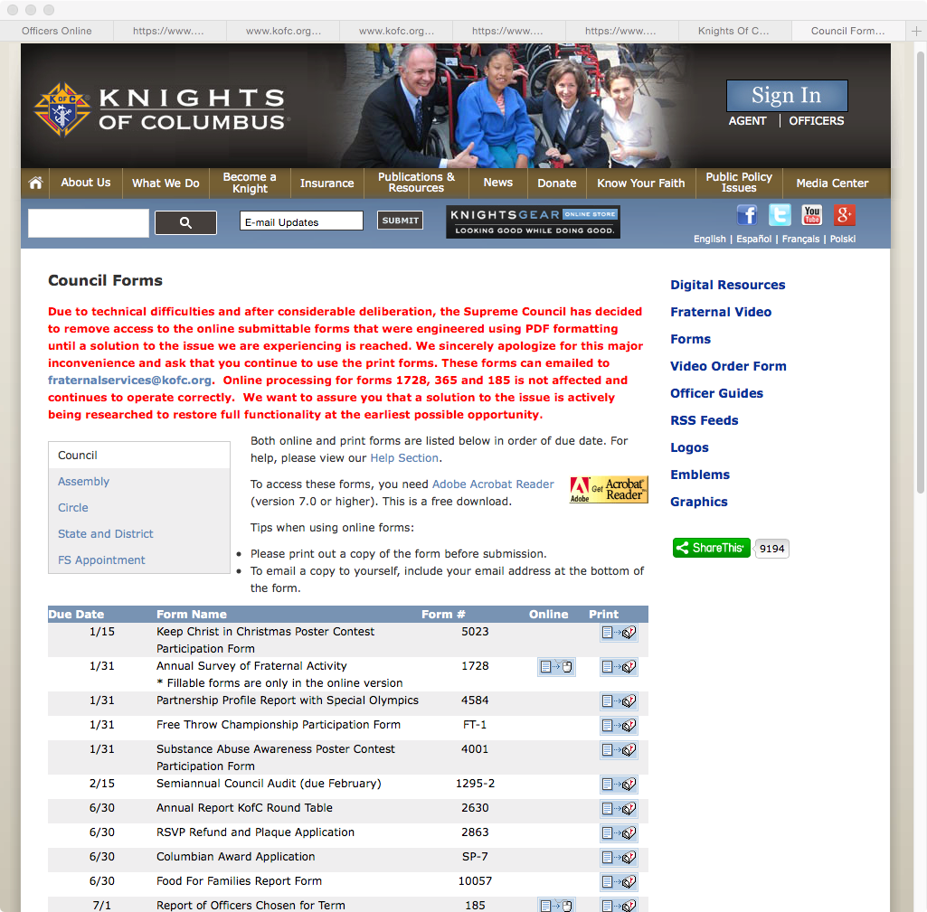
Council Audit Reports
Council Report Forms
Booklet # 1436
Order from Supreme Supplies
Supreme Web Site (www.kofc.org) under Publications/Forms/Council

Slide 46
Council Audit References
Audit Procedures - Step by Step Outline
Grand Knight’s Handbook #915
Financial Secretary’s Handbook #1410

Slide 47
Council Audit References
Audit - Additional References
Grand Knight’s Training Seminar Chapter 3
(Forms, Procedures & Paperwork)
District Deputy Handbook and Reference Guide

Slide 48
Council Audit
Questions Audit Presentation

Slide 49
The End

