Slide 1
Steve Hart
Programs

Slide 2
Agenda
Programs Team
Names and Responsibilities
Awards
Star Council
Service Program Awards (STSP forms)
State Deputy’s Award
3. Programs
Supreme programs
State programs
4. Resources
Star Council Tracker Report
Monthly Checklist
Status Reports
Fraternal Leader Advisory
KofC.org
LouisianaKC.org

Slide 3
Programs Team
Mark Carver State Program Director
Steve Hart State Family Director
Keep Christ in Christmas Poster Contest Chairman
Delmas Forbes State Community Director
State Youth Director (Soccer, Free Throw, Essay)
C.Y.L.A. Chairman
Don Ducote State Faith Director
State Retreat Chairman
Ronald Dupuis State Life Director
Special Olympics Chairman

Slide 4
Programs Team
Vicen Alvarez Silver Rose Chairman
Mike Rose Pilgrim Icon Chairman
Vernon F. Ducote Seminary Mission Fund Chairman
Vince Whittington Y.E.P. Chairman
Tommy Ruemker Intellectual Disabilities / St. Mary’s Training School
Robert Boudreaux Athletics and Cook-Offs Chairman

Slide 5
Importance of Awards
Provides roadmap to success for councils to follow.
Sets the expectations of State Council and Supreme Council.
Identifies items that are important to State and Supreme Council.
Helps motivate members and councils to be active.

Slide 6
Importance of Awards
Provides credibility to the council.
Recognizes the council’s achievement.
Expresses State Council and Supreme Council’s appreciation.

Slide 7
Star Council
Requirements
Earn the Fr. McGivney Award (membership quota)
Earn the Founders’ Award (fraternal benefit nights)
Earn the Columbian Award/Form SP7 (programs)
Submit Form 365 (Report of Service Personnel)
Submit Form 1728 (Annual Fraternal Survey)
Be safe environment compliant
Pay Supreme per-capita
By June 30th

Slide 8
Star Council
Safe Environment
The Family, Community, and Program Director must be three different individuals.
The Grand Knight can be the Family, Community, or Program Director.
If the Family, Community, and Program Director fails to become safe environment compliant within 30 days, Supreme will automatically remove the individual from his position.

Slide 9
McGivney Award
Membership
Membership quota is 5% of the council’s membership as of July 1.
For small councils: Minimum 3 (less than 61)
For large councils: Maximum 20 (more than 381)
Suspensions and withdrawals count against the quota.
Deaths and transfers do not count for or against the quota.
Adding online members and former members count towards the quota.

Slide 10
Founder’s Award
Insurance
Conduct two (2) Fraternal Benefits Nights
Conduct 3 promotion activities for each FBN.
Submit Form 11077 to your General Agent.
Form 11077 will ask the council to identify which promotion activities were conducted by the council.

Slide 11
Founder’s Award
Must do 3 promotion actions.
Email blast to all council members (mandatory requirement).
And any of the following two:
Social Media announcement on the council’s social media platform.
Church Bulletin announcement / Post event signs in Church.
Parish Email Blast / Parish Social Media announcement.
Parish Pulpit Announcement.
Send email to specific prospects and candidates.
Other method of promotion approved by the General Agent.

Slide 12
Columbian Award
Programs
Report 4 programs in each Faith in Action category.
Report 16 total programs.
Featured programs count as 2 programs. Doing less than the minimum requirements of the Featured Program will count as 1 credit.
Councils can do their own unique programs. Councils do not have to do Supreme’s recommended programs.
Submit SP7 (Columbian Award Application) by June 30.

Slide 13
STSP
State Service Program Awards
Who has the best Program?
Councils submit STSP entry forms describing their best Faith, Family, Life, and/or Community program.
Postal mail the entry form and supporting pictures and materials to Robert Boudreaux so that he receives it by April 5th.
The State Deputy will pick the best program in each of the four categories of Faith, Family, Life, and Community.
State winners will compete in the International competition.

Slide 14
Louisiana State
Deputy’s Award
Focuses on items to help councils achieve Star Council.
Focuses on programs that are important to the Louisiana State Council.
Every Louisiana council can earn the State Deputy’s Award (if it meets the minimum requirements set forth in the criteria).

Slide 15
Action | Event | Points
Mandatory | Must Recruit 1 New Member | 0
Membership | Quota | 100+
Insurance | Fraternal Benefit Nights credit | 100
Submit | Form 185 (Officers) | 100
Submit | Form 365 (Directors) | 100
Submit | Form 1728 (Fraternal Survey) | 100
Safe Env. | Be compliant. | 200
Support | Special Olympics / Submit Report (Form 10784) | 100
Support | Pay State Per Capita | 100
Support | Youth Expansion Program (quota) | 200
Support | Seminary Mission Fund ($200) | 100
Support | St. Mary’s Training School / Submit Report | 100
Participate | KCLS | 100
Participate | State sponsored meeting (state-diocesan meetings) | 100
Participate | Cook Off or Athletic Event | 100
Participate | CYLA | 100
Confirm | GK and FS confirms receipt of State’s emails | 200
Training | Grand Knight Training Test | 100
 | 1,600 points needed to earn the Award. | 2,000

Slide 16
Faith in Action Programs
Don Ducote
Faith Director

Slide 17
Faith in Action Programs
Faith
Featured Programs
RSVP
Holy Hour
Spiritual Reflection
Into the Breach
Building the Domestic Church Kiosk
Rosary
Sacramental Gifts
Pilgrim Icon Program (Mike Rose, Chairman)

Slide 18
Faith
Refund Support Vocations Program (RSVP): Donate at least $500 to a single seminarian. (Form #2863)
Holy Hour: Conduct at least one Eucharistic Adoration every quarter.
Spiritual Reflection: At least 10 men or 10% of your council, whichever is fewer, must participate in a day long reflection or retreat.
Into the Breach: Conduct 8 (1 hour) small group sessions to discuss the videos.
Building the Domestic Church Kiosk: Buy the display and the Catholic Information Services books ($150).
Rosary Program: Promote devotion to the rosary in your families and parishes by scheduling regular rosary prayer services. (#SR-KIT)
Sacramental Gifts: Recognize parishioners and individuals who receive a Holy Sacrament with a gift.
Pilgrim Icon Program: Host and conduct prayers and devotion using the travelling icon as the centerpiece.

Slide 19
State Program
State Retreat
Schriever, LA.
January 14, 15, and 16, 2022
It is NOT a silent retreat.
Atmosphere is relaxed, casual and prayerful.
$200 per person (includes room and meals)

Slide 20
Supreme Program
Mike Rose
Pilgrim Icon Chairman

Slide 21
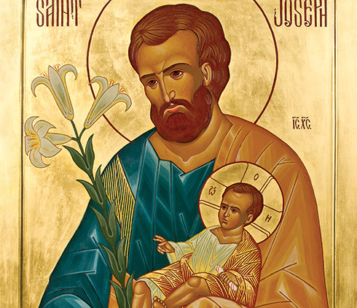
Pilgrim Icon Program
1 hour prayer service honoring St. Joseph which includes:
Hymns
Scripture
Papal Reflections
Rosary
Litany to St. Joseph
Icons travel from council to council for these prayer services.
Icon by the hand of Elizabeth Bergeron.
Based on a drawing by Alexandre Sobolev. Photograph by GrapheStudio

Slide 22
Faith in Action Programs
Steve Hart
Family Director

Slide 23
Faith in Action Programs
Family
Featured Programs
Food for Families
Family of the Month
Family Prayer Night
Family Fully Alive
Consecration to the Holy Family
Family Week
Good Friday Family Promotion
Keep Christ in Christmas

Slide 24
Family
Food for Families: Collect at least $500 or 1,000 pounds of food for a food pantry and perform at lease 100 total man-hours for the preparation / distribution of meals. (Earn up to $500 in refunds from Supreme.) (Form #10057)
Family of the Month and Year: Recognize twelve families throughout the fraternal year and submit a Family of the Year nomination to the State Family Director. (Form #10784/10680)
Family Prayer Night: Organize an evening of prayer, dinner, and fellowship (at least once each quarter).
Family Fully Alive: Distribute and promote the use of the Family Fully Alive Booklet.
Consecration to the Holy Family: Pray and promote the prayer. (#10371 Prayer Card)
Family Week: Dedicate a special week with programs to recognize the importance of families.
Good Friday Family Promotion: Promote Good Friday services.
Keep Christ in Christmas: Promote the spirit of Christmas; do the poster contest. (CPC-KIT)

Slide 25
State Program
Steve Hart
Family Director
Keep Christ in Christmas Poster Contest

Slide 26
Keep Christ in Christmas
Poster Contest
Open to any child ages 5 to 13.
(Children compete in 3 age groups).
December 10: Deadline for students to complete the contest.
December 31: Deadline for councils to submit winning posters to the Diocesan Administrator.
January 18: Deadline for Diocesan Administrators to submit winning posters to Steve Hart.

Slide 27
Faith in Action Programs
Delmas Forbes
Community Director

Slide 28
Faith in Action Programs
Community
Featured Programs
Global Wheelchair Mission
Habitat for Humanity
Coats for Kids
Leave No Neighbor Behind (LNNB)
Helping Hands
Catholic Citizen Essay Contest
Free Throw Championship
Soccer Challenge
Disaster Preparedness (Bill McCrossen, Chairman)

Slide 29
Community
Global Wheelchair Mission: Donate 10 wheelchairs ($150 per chair).
Habitat for Humanity: Donate at least $1,000 or 200 service hours to Hab. for Hum.
Coats for Kids: Purchase and distribute 6 cases of coats (approx. cost $1,400).
Leave No Neighbor Behind (LNNB): Do an activity in all five categories. 1. Support your brother knights, 2. Support your parish, 3. Support your community, 4. Feed the
hungry, and 5. Participate in blood drives.
Helping Hands: Help a group of disadvantaged persons (homeless, elderly, etc.)
Catholic Citizen Essay Contest: Catholics children in grades 8 to 12.
Free Throw Championship: Boys and girls ages 9 to 14.
Soccer Challenge: Boys and girls ages 9 to 14.
Disaster Preparedness: Engage the community in disaster “preparedness” by organizing training, fundraisers, and various awareness activities.

Slide 30
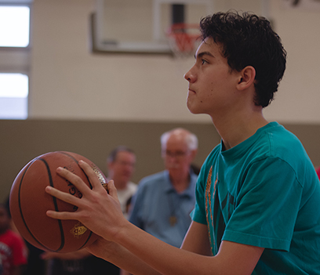
Free Throw Contest
Open to Boys & Girls 9 to14 years old.
Age is Determined by Jan 1st
Council Deadline: Jan 31, 2022

Slide 31
Catholic Youth Leadership Award (CYLA)
CYLA
Cash scholarships offered to Catholic 12th graders in public, parochial, or private school.
Each council can select 1 Boy and 1 Girl winner.
Send your winning application to your Diocesan Administrator.
1st Place: $4,000
2nd Place: $2,000
3rd Place: $1,000
Diocesan: $1,000

Slide 32
Catholic Youth Leadership Award (CYLA)
Use the Grading Guide
Councils chairmen and Diocesan Administrators must use the Grading Guide.
The guide provides a uniform scoring system.
Do not assume the student with the highest Grade Point Average is the winner.
This is a leadership award.

Slide 33
Catholic Youth Leadership Award (CYLA)
January 25: Deadline for students to submit winning boy and girl applications to the council.
February 7: Councils must submit winning entries to their Diocesan Administrator.
March 1: Diocesan Administrator must submit its winning entries to Delmas Forbes.
April 2: State Finals in Plaquemine.
Confidential Grading Guide: Contact Delmas Forbes.

Slide 34
State/Supreme Program
Tommy Ruemker
Campaign for People with Intellectual Disabilities Chairman

Slide 35
State/ Supreme Program
Campaign for People with Intellectual Disabilities
https://www.louisianakc.org/programs/cpid/
Do not send your checks to the State Office. Send your donations directly to your beneficiary.
Please designate St. Mary’s Residential Training School as a beneficiary.
Complete the Financial Statement Report Form on the website.

Slide 36
Faith in Action Programs
Ronald Dupuis, Sr.
Life Director

Slide 37
Faith in Action Programs
Life
Featured Programs
March for Life
Special Olympics
Ultrasound
Pregnancy Center Support
Novena for Life
Christian Refugee Relief
Mass for People with Special Needs
Silver Rose (Vicen Alvarez, Chairman)
State Program: Angel Wings Award

Slide 38
Life
March for Life: Get at least 25 marchers to participate in a march, or a council can organize its own march.
Special Olympics: Donate at least $2,000 or volunteer 200 man-hours in support of Special Olympic activities.
Ultrasound: Raise 50% of the cost of the ultrasound machine.
Pregnancy Center Support: Support a pregnancy center through fundraising, volunteering, or prayer.
Novena for Life: Promote and participate in a 9 day prayer for life.
Christian Refugee Relief: Spread awareness and raise funds for Christian refugees.
Mass for People with Special Needs: Sponsor a distinct Mass for people with special needs.
Silver Rose: Participate in the program regarding these silver roses that travel from Canada to Mexico.

Slide 39
Special Olympics Report Form
Supreme allocates $180,000 for Special Olympics among the jurisdictions in North America.
The allocation is based on how much money councils donated to Special Olympic and how many hours councils volunteered.
By January 31, 2022, councils must report their support of Special Olympics using Form 10784 for the year 2021.
The support that Louisiana councils report by January 31st will increase the amount of money Supreme will donate to Louisiana Special Olympics.
If a councils provided any type of support to the Special Olympics in 2021, then they must report it by January 31, 2022.

Slide 40
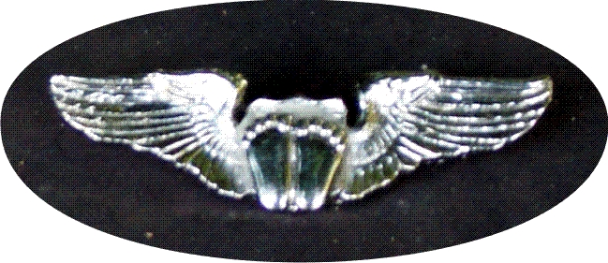
Angel Wings Lapel Pin
Anyone can earn these Pro-Life wings.
The wings recognize a person’s active support and participation Pro-life events and activities.

Slide 41
State Programs
Robert Boudreaux
State Administrator

Slide 42
CORN HOLE FEBRUARY 5…METAIRIE

Slide 43
FREE THROW MARCH 12…LAFAYETTE

Slide 44
TEXAS HOLD ‘EM APRIL 9…looking for host

Slide 45
State Program
Vince Whittingt0n
Youth Expansion
Program Chairman

Slide 46
State Program
YEP
Quota: $10 for each “Regular Member.”
“Regular member” does not include Inactive, Members, Honorary Members, Honorary Life Members, and Disabled Members.
Supports:
Youth Contests (Free Throw, Posters, etc.)
CYLA (college scholarships)
Seminarians
Right to Life

Slide 47
State Program
YEP
Make checks payable to “Louisiana State Council.”
Put “YEP” and the council number on the check.
Mail donations to:
Vince Whittington, State Secretary
13644 Timberridge Avenue
Baton Rouge, LA 70817-3441

Slide 48
State Program
Vernon F. Ducote
Seminarian Mission
Fund Chairman

Slide 49
State Program
Seminary Mission Fund
Helps pay the cost of mission trips for seminarians.
Requested donation is $200 or more per Council.
Drawing will be at the State Convention banquet.
Mail raffle tickets stubs, money, and donations to:
Vernon F. Ducote, PSD
3030 Congress Blvd, Apt 106
Baton Rouge, LA 70808

Slide 50
State Program
Bill McCrossen
Disaster relief Chairman

Slide 51
Emergency Management & Relief
State Emergency Management & Relief Coordinator:
Bill McCrossen
1223 Clearwater Drive
Mandeville LA 70471
770-354-5379 (C)
disaster@louisianakc.org

Slide 52
Disaster Relief Request Form
Please access this form if you or someone you know is in need of assistance!
Find it on the State website:
Louisianakc.org/Programs
Emergency Management & Relief
Submit form to:
Bill McCrossen
disaster@louisianakc.org
(770) 354-5379

Slide 53
Disaster Relief Assistance Request Form

Slide 54
Monetary Donations?
Checks should be made payable to the Louisiana State Council
Send all monetary donations to:
Vince Whittington, State Secretary
13644 Timberridge Avenue Baton Rouge LA 70817

Slide 55
Resources
Star Council Tracker Report by Supreme.
Fraternal Leader Advisory by Supreme
Monthly Checklist by State Program Director
Deadlines; forms due; upcoming events; reminders
Status Reports by State Program Director State Deputy Award progress; event participation, etc.
KofC.org & LouisianaKC.org

Slide 56
FOR MEMBERS

Slide 57
Programs

Slide 58
FORM 10784
Fraternal Program Report Form
Submitted Online Only
Replaces most forms, including Family of the Month.
Encourage councils to report all their programs to Supreme using Form 10784.

Slide 59
Miscellaneous
What is the password to the State Directory?
Why use Bishop Greco Fund Memorial Mass Cards?
Did you know the most recent 20 emails / newsletters from the State Program Director can be found at LouisianaKC.org on the Programs page?
Why use #LAKOFC in your council’s Facebook posts?

Slide 60
LouisianaKC.org/Programs
Questions?

Slide 61
Vivat Jesus!

