Slide 1
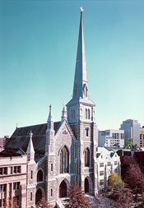
Church Activity

Slide 2
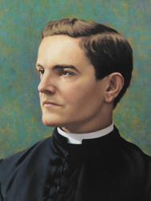
Vocations
RSVP Program
https://www.kofc.org/en/members/programs/vocations/refund-support-vocations-program.html#/
Seminarian Mission Fund Raffle
Bishop Greco Foundation

Slide 4
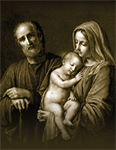
Building the Domestic Church While Strengthening Our Parish
Holy Family Prayer Program
(Marian Icon)
5th Sunday Rosary
(SR-KIT)
Consecration to the Holy Family
(Prayer Cards #10371)

Slide 5
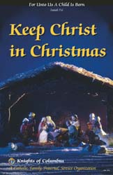
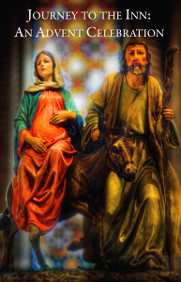
Building the Domestic Church While Strengthening Our Parish
Keep Christ in Christmas
(CPC-Kit)
Journey to the Inn
(Form 9898)

Slide 6
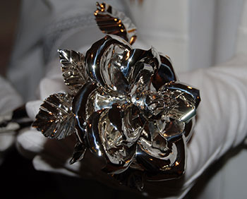
Building the Domestic Church While Strengthening Our Parish
Silver Rose Program

Slide 7
Church Activity Director
Questions:
Stephen Hart
Church Activity Director
123 Iroquois Dr.
Abita Springs, LA 70420
heartfore@bellsouth.net
(504) 615-1303

