Slide 1



Slide 2

History
The Special Olympics were started by Eunice Kennedy Shriver.
  Wife of Sargent Shriver
  Sister of President John F. Kennedy
  Both were Knights of Columbus.
Her sister Rosemary had an intellectual disability, and there were limited programs for people like her sister. She wanted people with intellectual disabilities to have the same opportunity in life as everyone else.
The first International Special Olympics were held in Chicago in 1968.
https://www.specialolympics.org/eunice-kennedy-shriver/bio
https://www.specialolympics.org/about/history

Slide 3
Organizational Structures
Knights of Columbus
Special Olympics
Supreme Council
Louisiana State Council
Diocese (7)
District (60)
Local Councils (300+)
International
Regional – North America
National – USA
Louisiana
Area (9)
Local Programs (51 as of 12/2021)

Slide 4
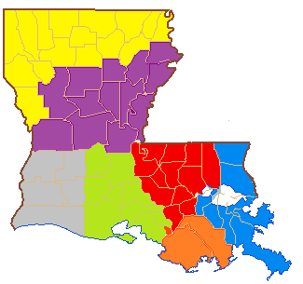
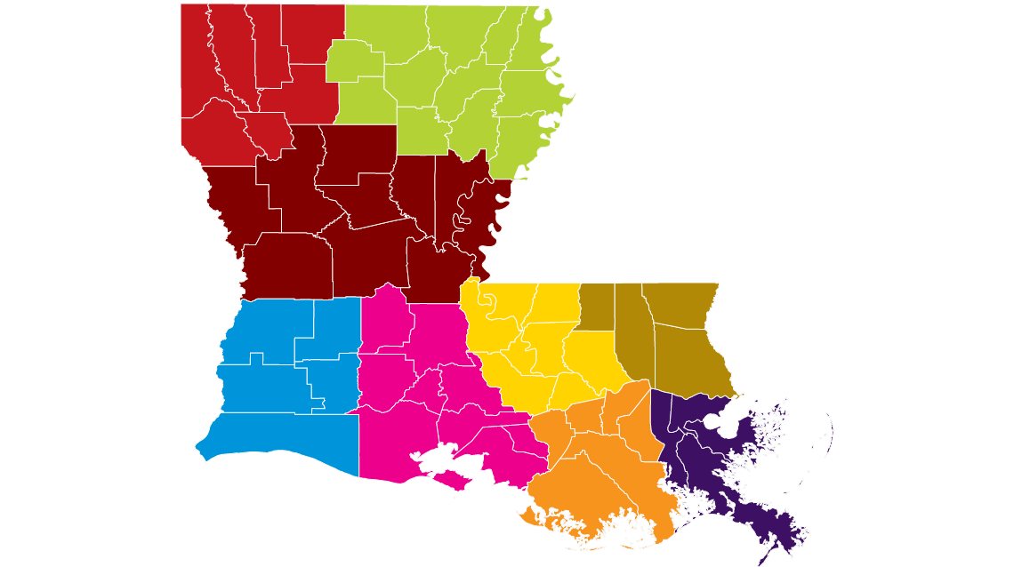
Maps
Knights of Columbus – Diocese (7)
Special Olympics – Areas (9)

Slide 5
What can your council do to support Special Olympics?
Donate Money
Volunteer Time
Report the data to the Supreme Council

Slide 6
Local Special Olympics
As of 12/2021, there are 51 Special Olympics programs in Louisiana.
  List is on Louisiana State Council website.
  State Chairman / Webmaster will work to post updated list.
School programs run through the local school board.
Community programs run outside of the local school board.
Special Olympics Louisiana website has a map with a contact form.
Donate to the local program and volunteer at their events.

Slide 7
Special Olympics Louisiana
Whether or not there is local program near you, any council can assist Special Olympics Louisiana.
Special Olympics Louisiana website has
  A “Donate Now” link to make an online donation.
  A “Calendar” link for list of upcoming events.
The State Summer Games take place in May at Southeastern Louisiana University in Hammond.

Slide 8
Report your council’s activity
Report your council’s monetary donations and volunteer hours.
Use Fraternal Program Report Form 10784, by Jan. 31.
  Special Olympics Partnership Profile Form 4584 has been eliminated.
Any brother knight can complete this form.
  It does not have to be the GK, FS, Program Director.
Your donation can also be counted as a contribution for Campaign for People with Intellectual Disabilities.

Slide 9
Why report your council’s activity?
The Supreme Council donates money to State Special Olympics Programs based on the activity of these forms.
If a council donates $2000 or volunteers 200 hours, it qualifies for a featured program (counts for two programs for the Columbian Award).
In 2021 – 2022, Knights of Columbus for Special Olympics:
  Order-wide: donated $3.7 million and volunteered 418,000 hours.
    KnightLine, 8/29/2022 “Special Olympics Superfans”
  Louisiana: donated $13,532 and volunteered 3119 hours, #5 in the Order.
    Supreme Director Rennan Duffour, 4/30/2022 Louisiana State Convention

Slide 10
Additional Information
Louisiana State Council Special Olympics Information
  https://www.louisianakc.org/programs/specialolympics/
Special Olympics Louisiana
  https://specialolympicsla.org/
  Site has new domain. Old domain www.laso.org has redirect notice.
Special Olympics International
  https://www.specialolympics.org/
Supreme Council Information
  http://www.kofc.org/olympics
Supreme Council Fraternal Program Report Form 10784
  https://www.kofc.org/en/forms/spa/invite.html?lang=en&form=10784C.01
Brandon Hendricks
  specialolympics@louisianakc.org

