Slide 1
Online Membership 101

Slide 2
Opening Prayer

Slide 3
Why Online Membership?
New channels for membership recruitment
Eligible men who otherwise have not been invited to join
A continuous offer of membership
Modern communications and messaging
Streamlined process for prospects and councils

Slide 4
What Online Membership does
Gives prospective members a faster way to join
Amplifies the message of the Knights of Columbus.
Strengthens the K of C Brand and communication strategy
Gives us an opportunity to reach across generations, interests and availability

Slide 5
What is Online Membership?
An efficient way to join the Knights of Columbus
A predominately digital membership experience

Slide 6
What Online Membership does not do
Does not change the requirements for membership
Does not create a new class or type of member
Does not eliminate degrees
Does not eliminate councils

Slide 7
Who is an Online Member?
A practical Catholic male above the age of 18
A dues-paying member of a division of the state council
Eligible to purchase insurance
Recipient of the accidental death benefit (age restrictions apply)
Entitled to attend select local council and state council events

Slide 8
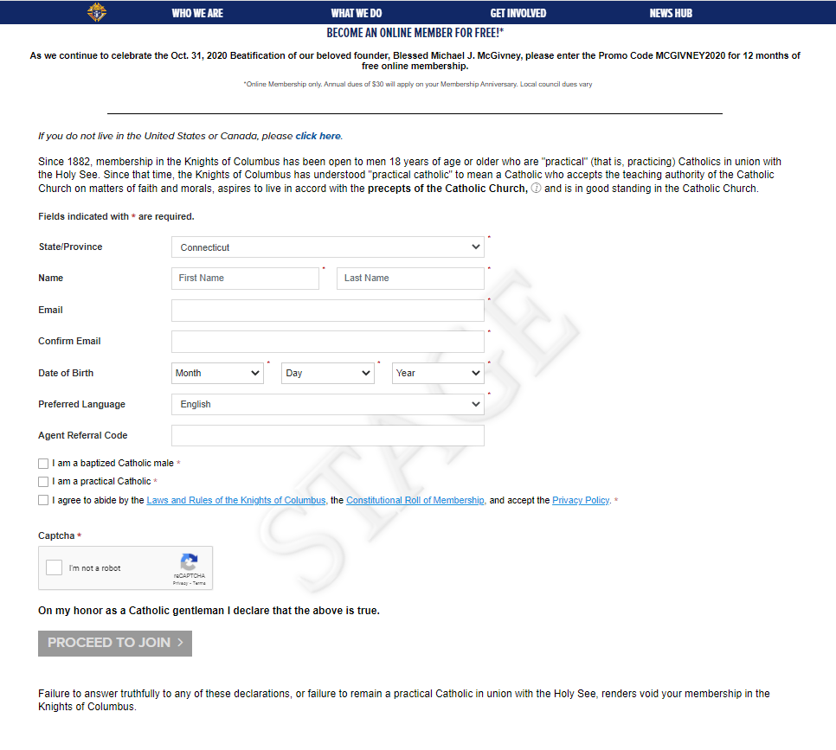

Slide 9
Eligibility
Forward concerns about transfer requests from Online Members to State Leadership and Supreme.

Slide 10
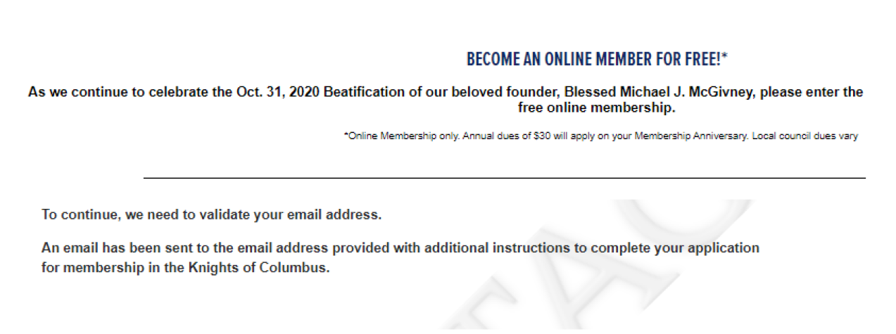
Eligibility

Slide 11
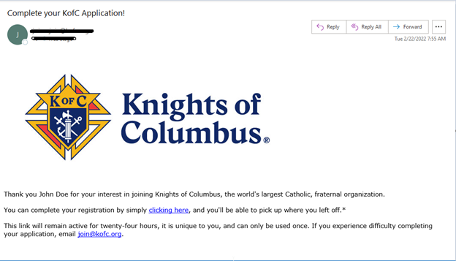

Slide 12
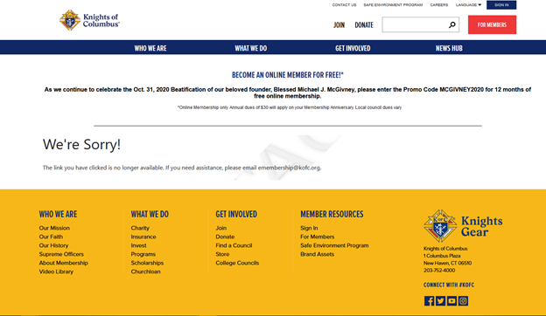

Slide 13
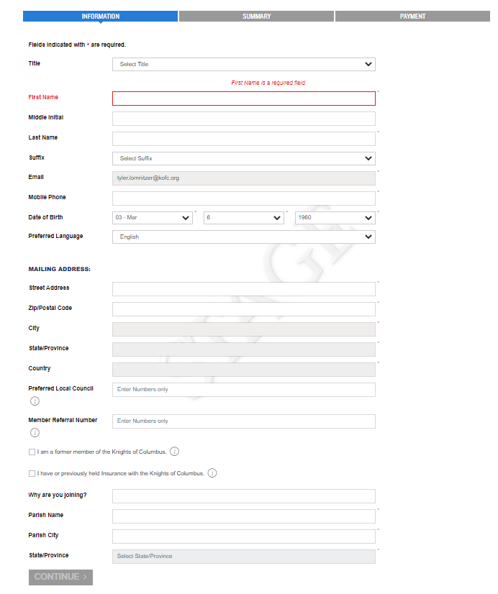
After confirming the email link, several of these fields will be prepopulated from the first page.
If there is a preferred local council, you can enter its number and the number of the member who referred you.

Slide 14
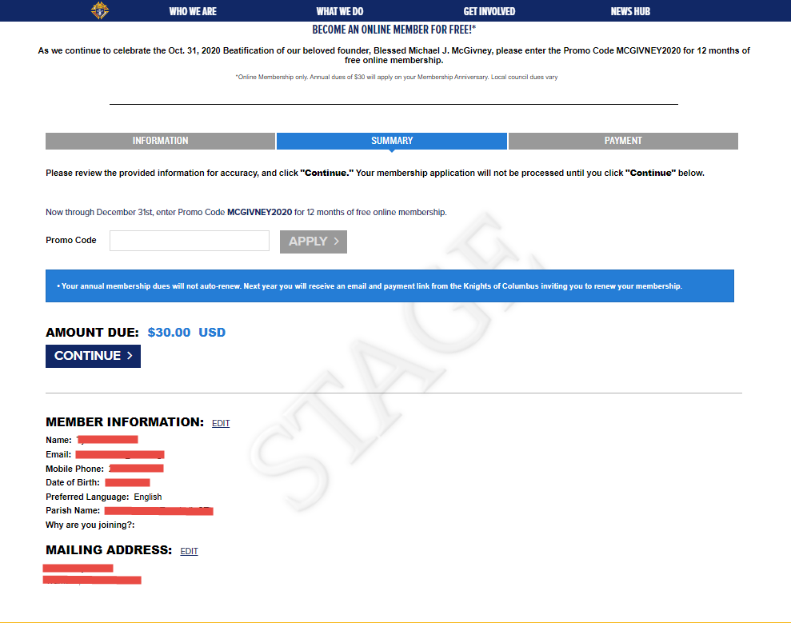
Be sure to press the APPLY button once the promo code is entered!

Slide 15
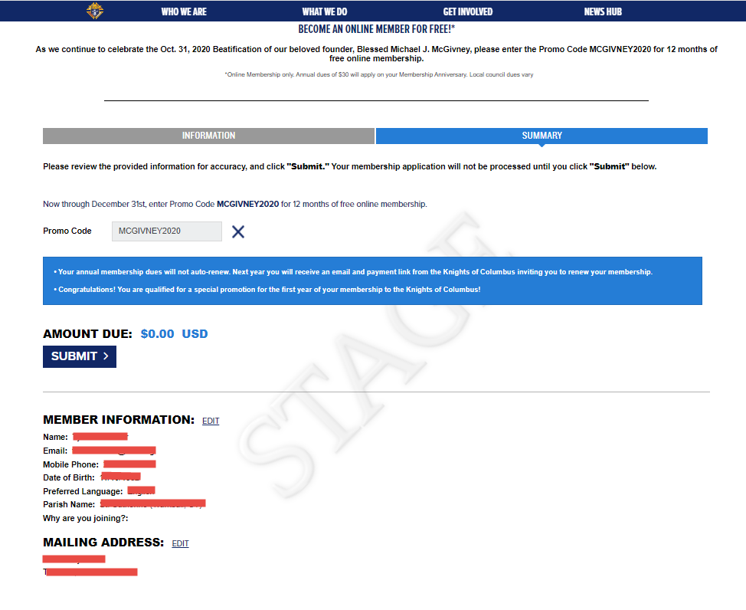

Slide 16
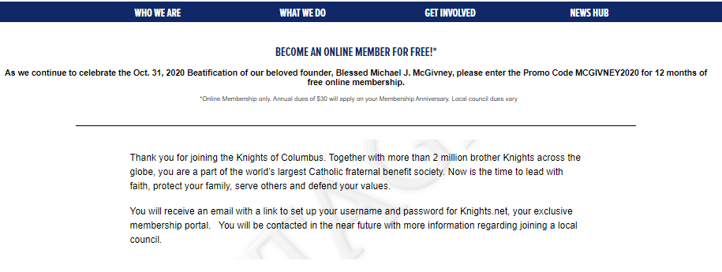

Slide 17
Online Member Welcome Packet
Member receives the following after Online registration:
Most recent month’s edition of Columbia.
eMembership brochure.
Blessed Michael McGivney Prayer Card.
Distinct Membership card in the mail showing a Member No. and his State Division.
Welcome letter from the Supreme Knight.

Slide 18
Online Membership and Councils
Online members belong to state divisions
Under the jurisdiction of the state council
Online members can convert to local council membership
Councils (and jurisdictions) receive membership credit when an online member converts to a local council.
Dues Adjustments will be processed by Council Accounts
States and councils are notified through reports and email when a member expresses interest in joining locally.

Slide 19
Transferring Online Members to Local Councils
Online Members are encouraged to transfer into local councils
When an Online Member transfers to a local council, that council will receive credit like a new member has joined the council
Online Members should be vetted the same way a new member to the council is vetted
Online Members must go through the ceremonial before being transferred
You can transfer Online Members via Form 100 or using Member Management

Slide 20
How to Transfer Members
All Online Members who express interest in joining a local council will appear under the “Prospect” tab in Officers Online
The prospect tab has two lists – “Unassigned” and “Assigned”

Slide 21
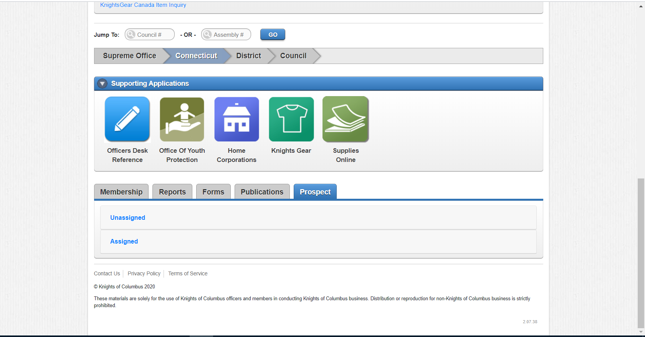
How It Works

Slide 22
Prospect Types
The “Unassigned” list will include online members who have expressed interest in joining locally but have not indicated a specific council number
The “Assigned” list will include online members who have expressed interest in joining locally and have included a specific council number.

Slide 23
Transferring Online Members
After prospects are assigned, they can be viewed by local councils in their prospect tab
The tab will ONLY be seen by Grand Knights and Financial Secretaries
Local Councils will not see an unassigned tab

Slide 24
Transferring Online Members
Once the member goes through the admissions process and has taken his ceremonial, he can be transferred
Add the Ceremonial Date
Hit Transfer

Slide 25
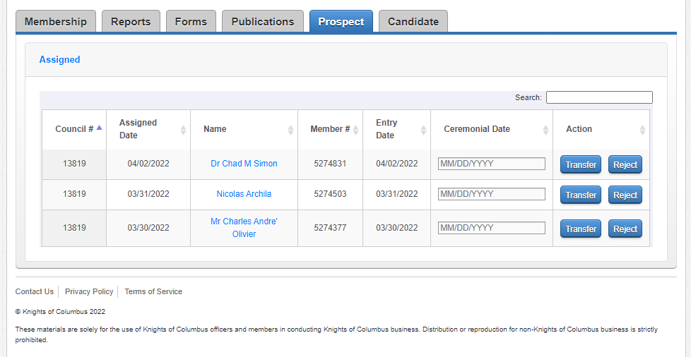
Transferring Online Members

Slide 26
Transferring Online Members
There is NO NEED to submit a form 100 when using this method
Councils will receive +1 when an online member transfers into a local council

Slide 27
Candidate Tab
The Candidate tab does not change the Online Membership process
State and Local Councils cannot move Online Members from the prospect tab to the candidate
In order to place an Online Member into the candidate tab, Grand Knights and Financial Secretaries must use the same method as they would a new member

Slide 28
Online Member Dues Adjustment
Online Members dues set at $30.00 for one year from date of entry
Council Accounts adjusts dues to the receiving council following a transfer
Dues adjustments must be applied to the member’s ledger as a credit towards the member's next full assessment
Financial Secretaries may request a check for a refund of the Dues Adjustment credits on their account by emailing Council.Accounts@kofc.org
Council credits are listed on your monthly council statement.

Slide 29
Email to State Deputy, Membership Director, Grand Knight & Financial Secretary when “Preferred Council” checked.

Slide 30
Email to member if a “Preferred Council” is gven

Slide 31
Printed Marketing Material (Card # 10536)

Slide 32
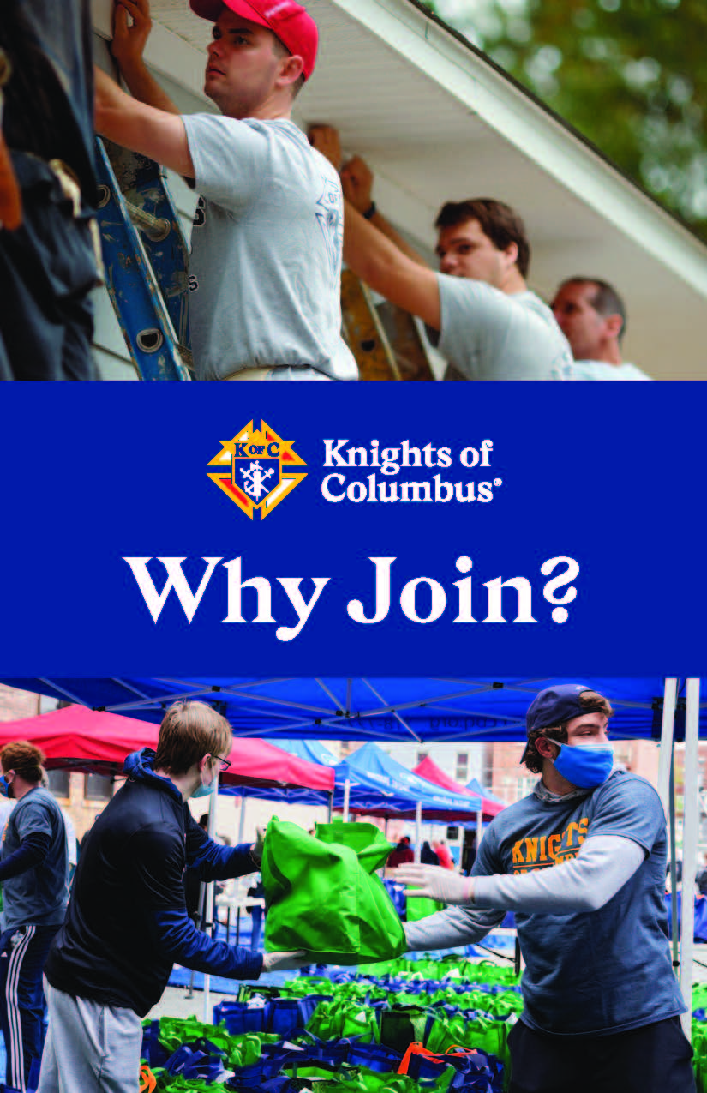
Printed Marketing Material Bifold # 10537

Slide 33
Next Steps?
Contact eMembership@kofc.org for any questions you may have regarding Online Membership.

Slide 34
Questions?

Slide 35
Prayer for the Canonization of Blessed Michael McGivney
God, our Father, protector of the poor and defender of the widow and orphan, you called your priest, Blessed Michael McGivney, to be an apostle of Christian family life and to lead the young to the generous service of their neighbor. Through the example of his life and virtue, may we follow your Son, Jesus Christ, more closely, fulfilling his commandment of charity and building up his Body which is the Church. Let the inspiration of your servant prompt us to greater confidence in your love so that we may continue his work of caring for the needy and the outcast. We humbly ask that you glorify Blessed Michael McGivney on earth according to the design of your holy will. Through his intercession, grant the favor I now present (here make your request). Through Christ our Lord. Amen.

Slide 36
Thank You!

